Slide 1

Screenshots of Dengue Project
Dengue Prevalence (2013-2020).pbix

Slide 2
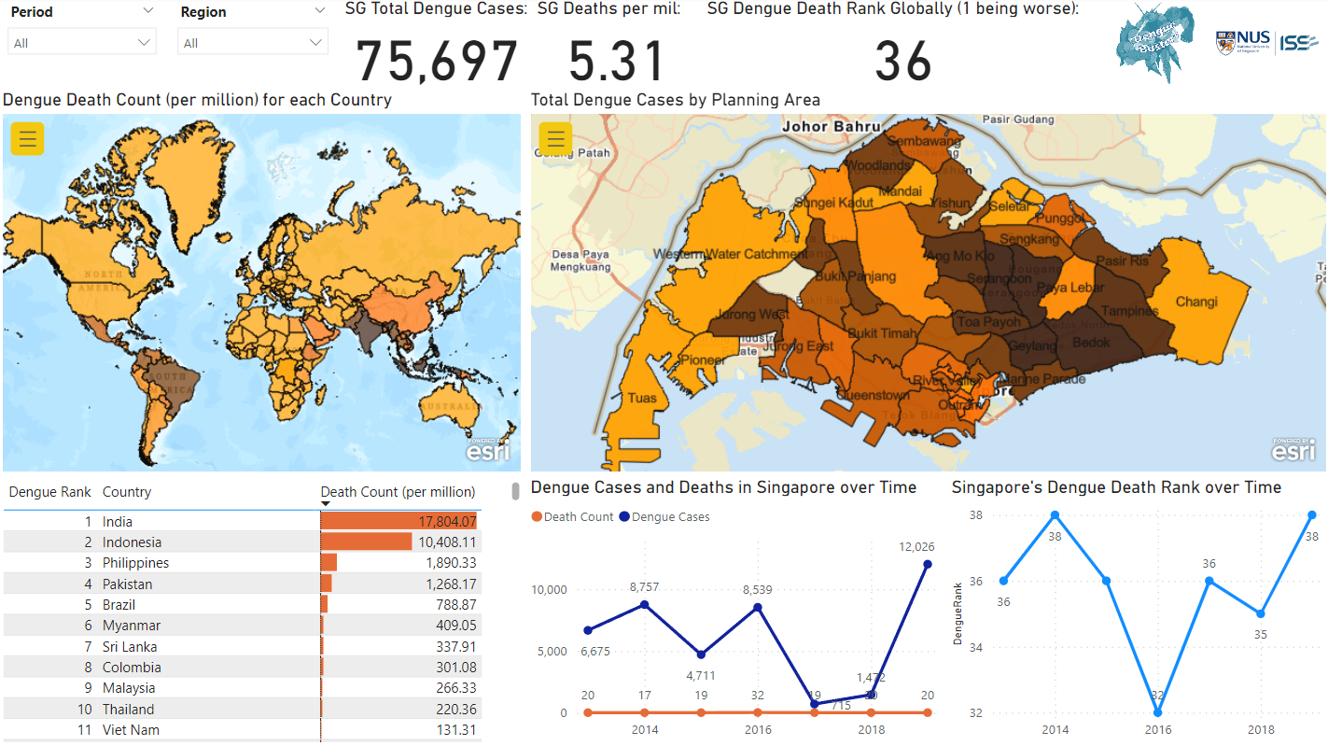
Incidence & Fatality

Slide 3
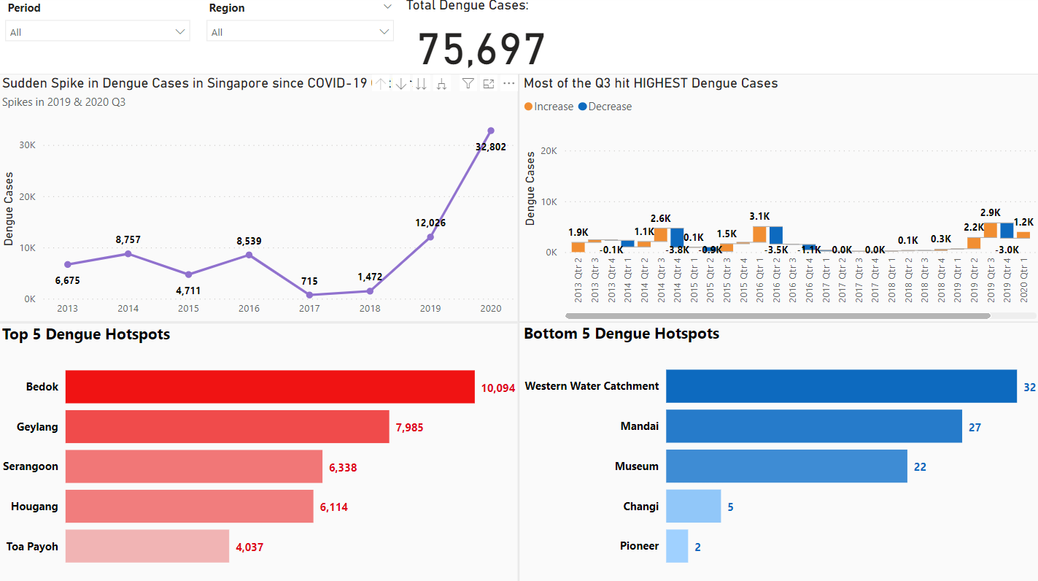
General Trends

Slide 4
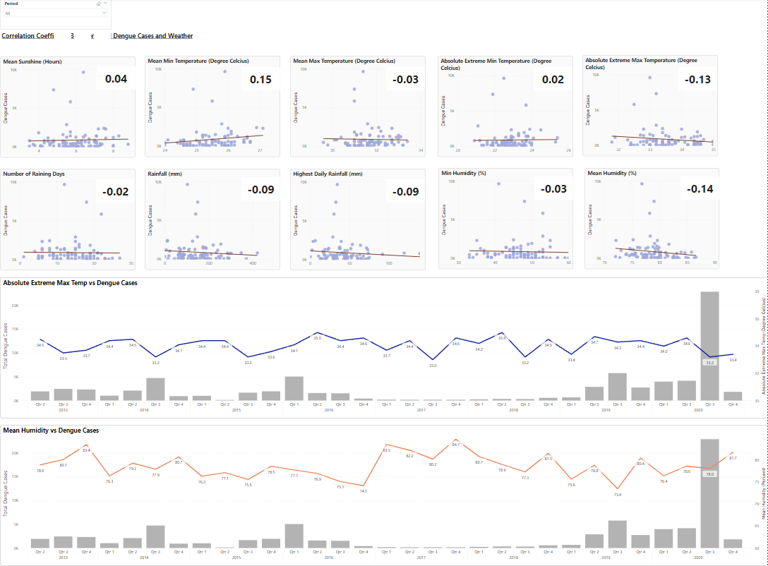
Scatterplots with Weather

Slide 5
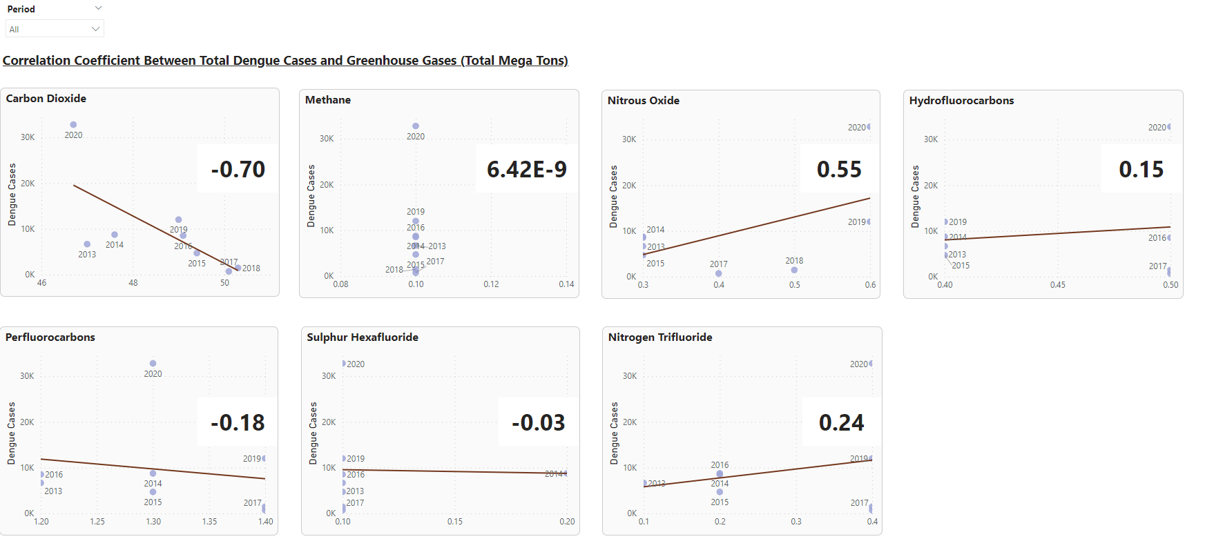
Scatterplots with Gases

Slide 6
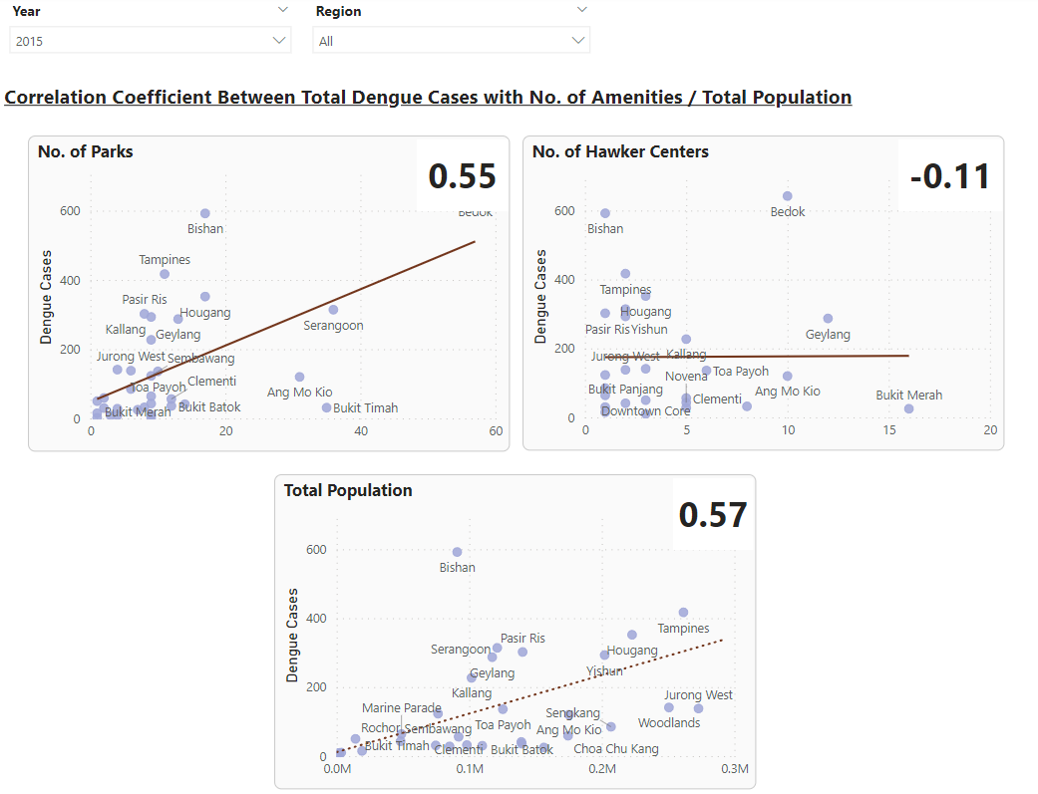
Scatterplots with Amenities & Population

Slide 7
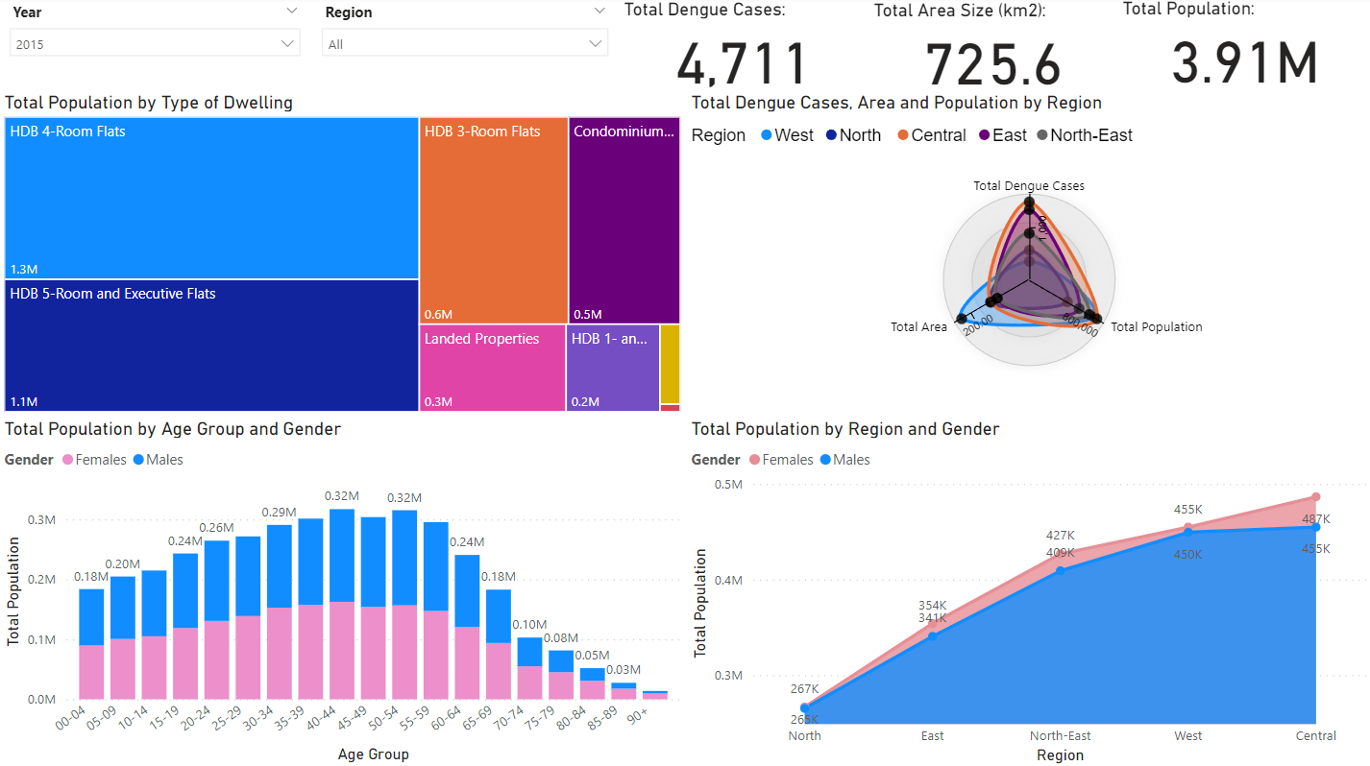
Population Demographics

Slide 8
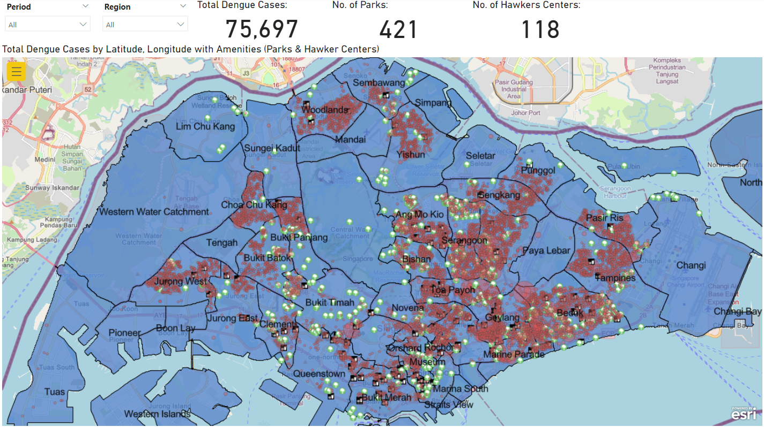
Dengue Cases with Amenities

Slide 9
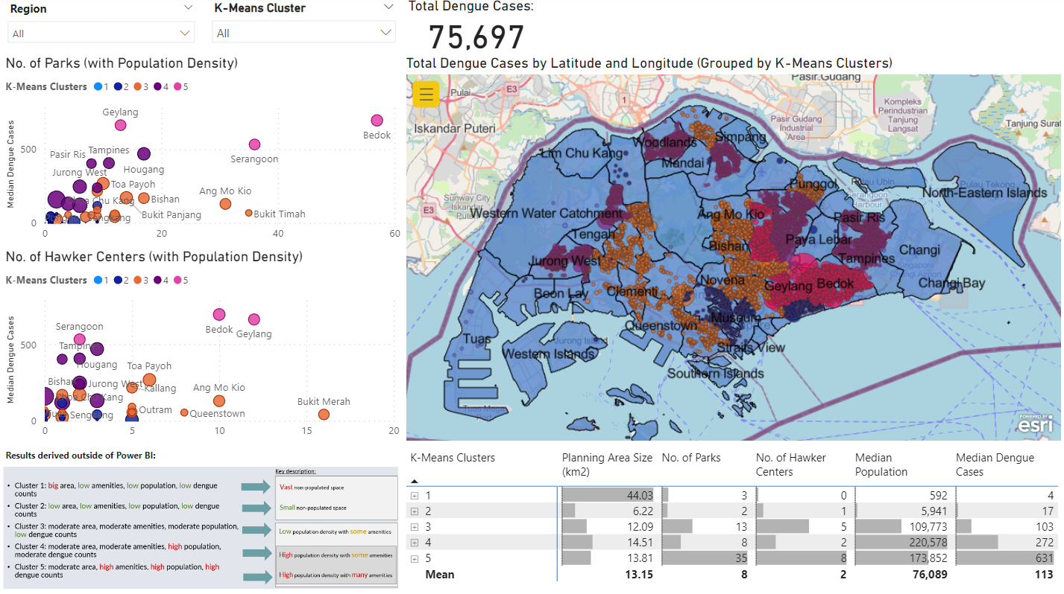
K-Means Clustering

Slide 10
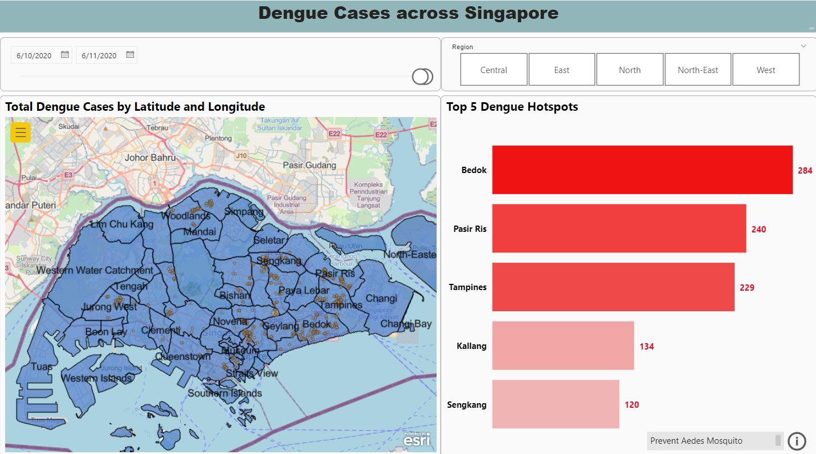
Notes:
External link:
https://www.nea.gov.sg/dengue-zika/stop-dengue-now

Slide 11
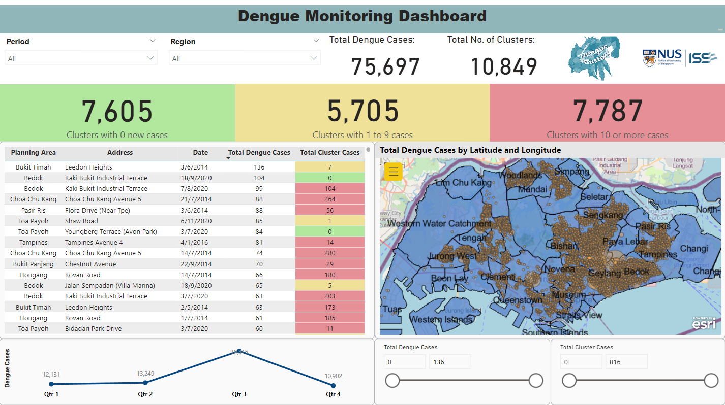

Slide 12
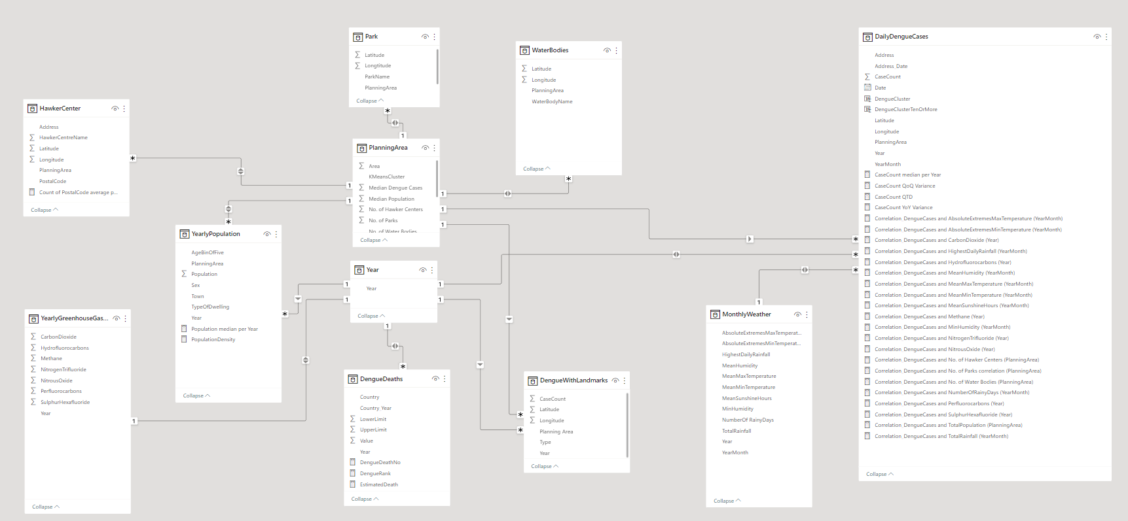
Data Model (Schema)

Slide 13
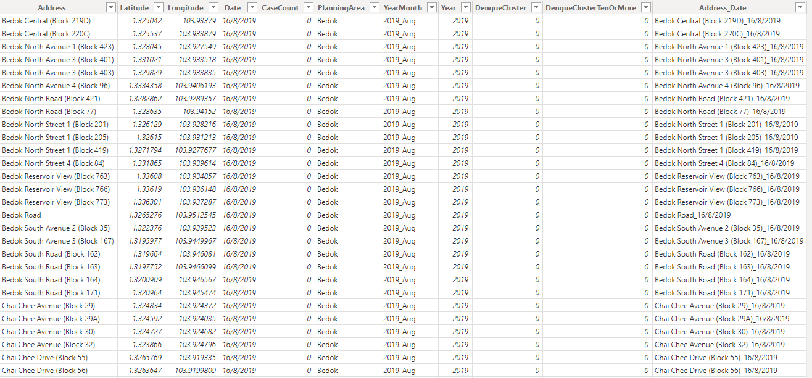
Sample Data (DailyDengueCases)

Slide 14
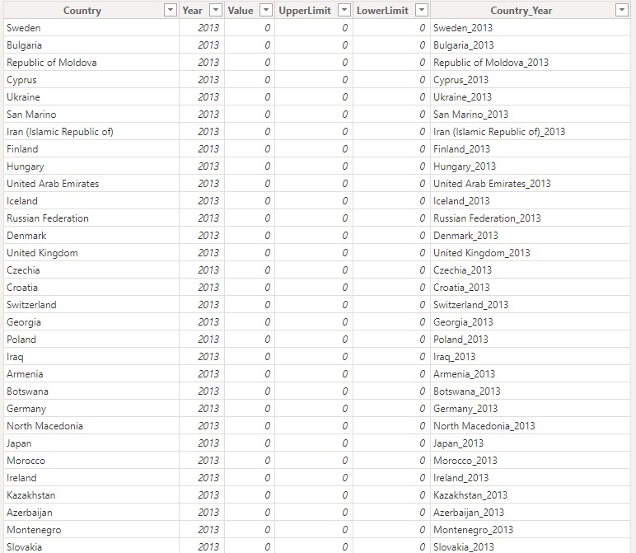
Sample Data (DengueDeaths)

Slide 15
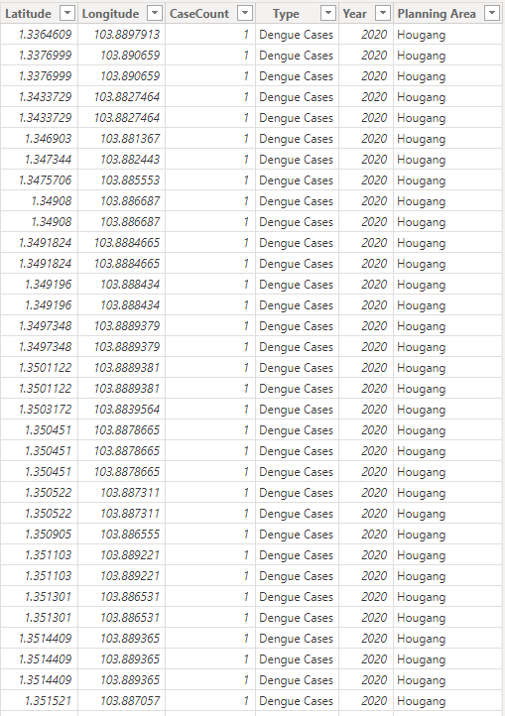
Sample Data (DengueWithLandmarks)

Slide 16
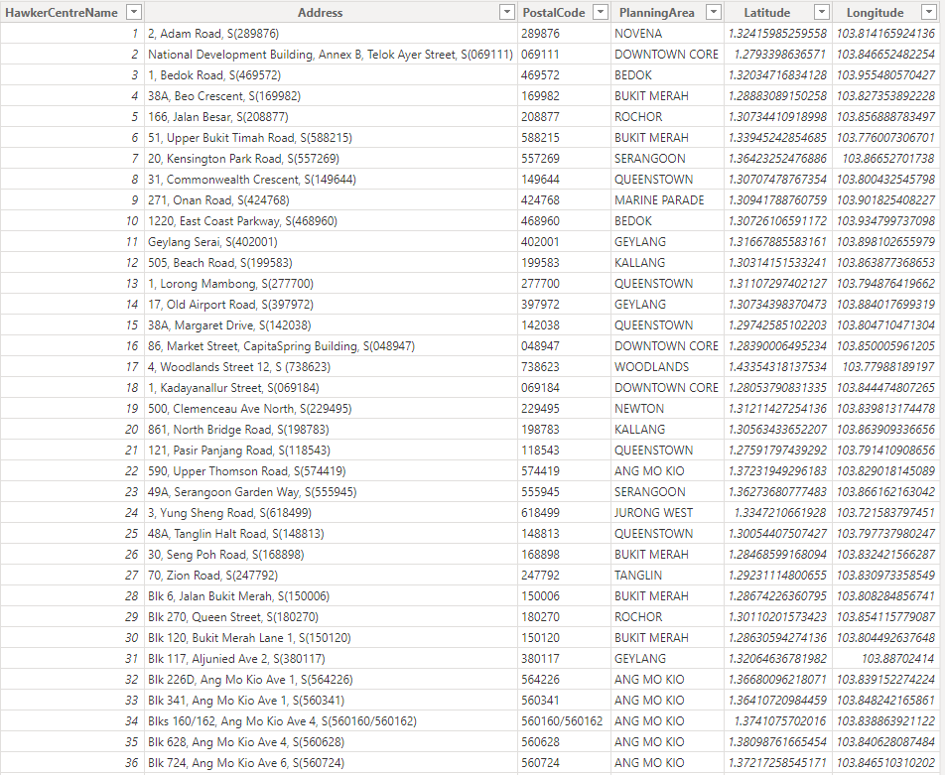
Sample Data (HawkerCenter)

Slide 17
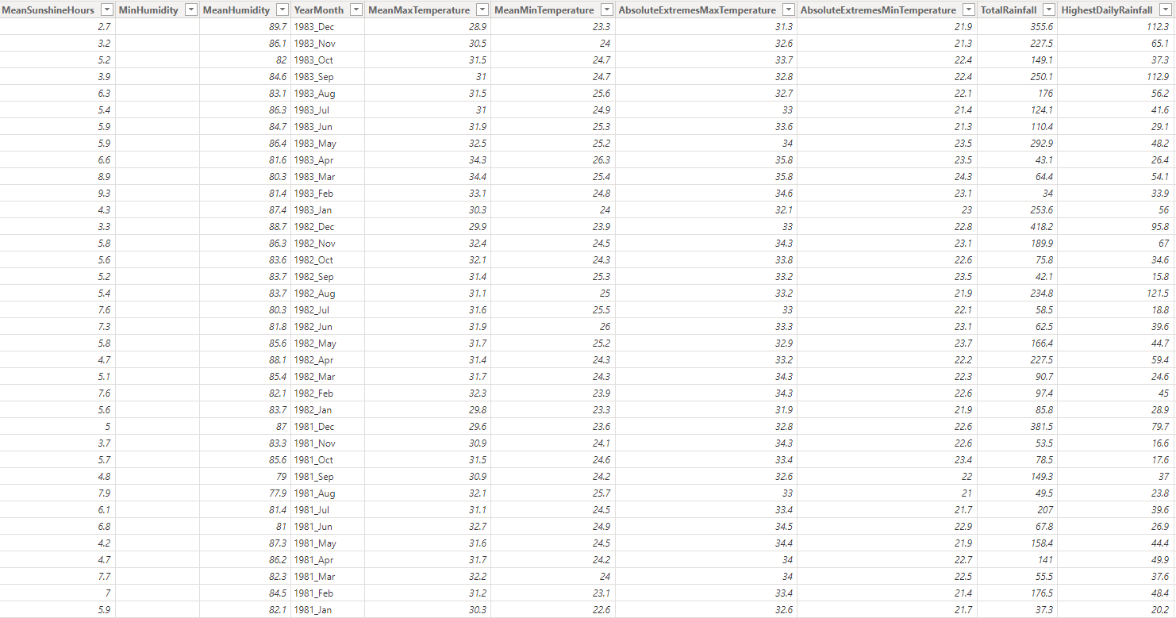
Sample Data (MonthlyWeather)

Slide 18
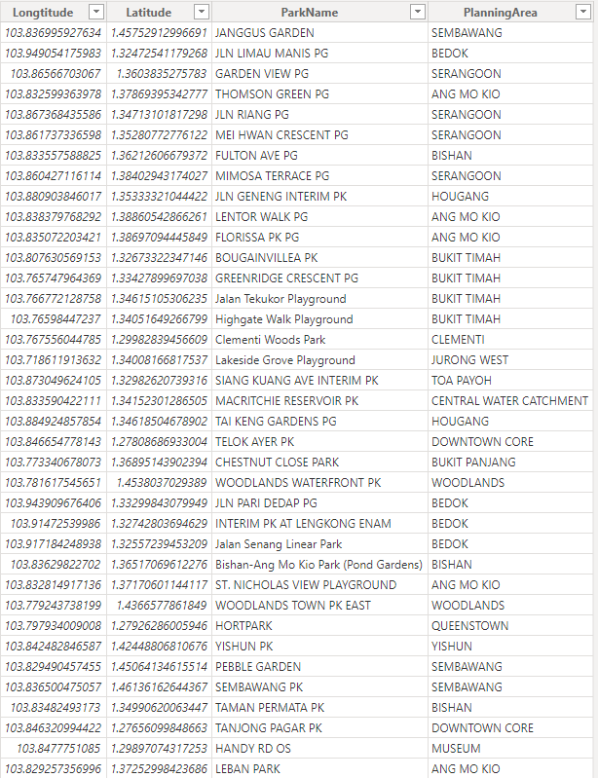
Sample Data (Park)

Slide 19
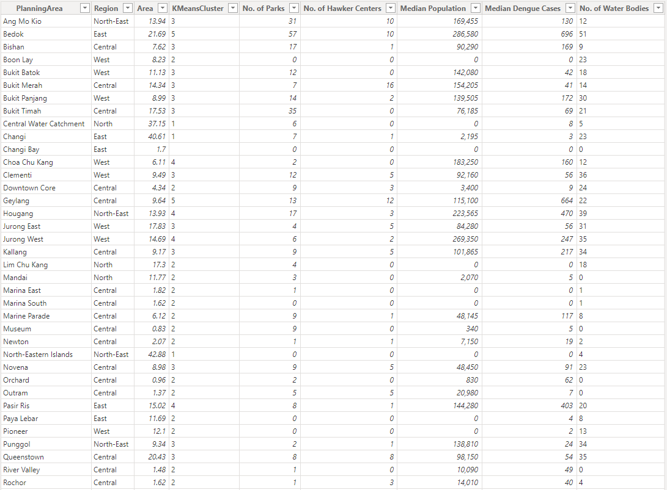
Sample Data (PlanningArea)

Slide 20
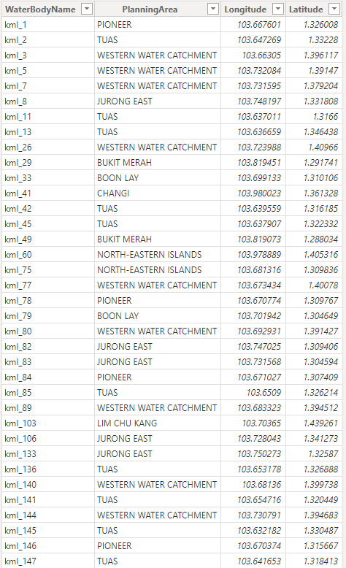
Sample Data (WaterBodies)

Slide 21
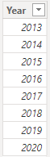
Sample Data (Year)

Slide 22
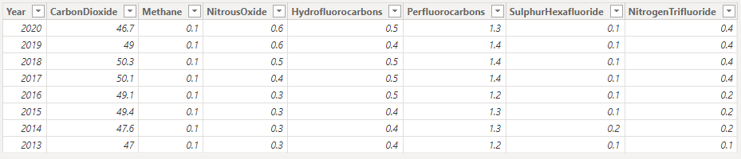
Sample Data (YearlyGreenhouseGasEmission)

Slide 23
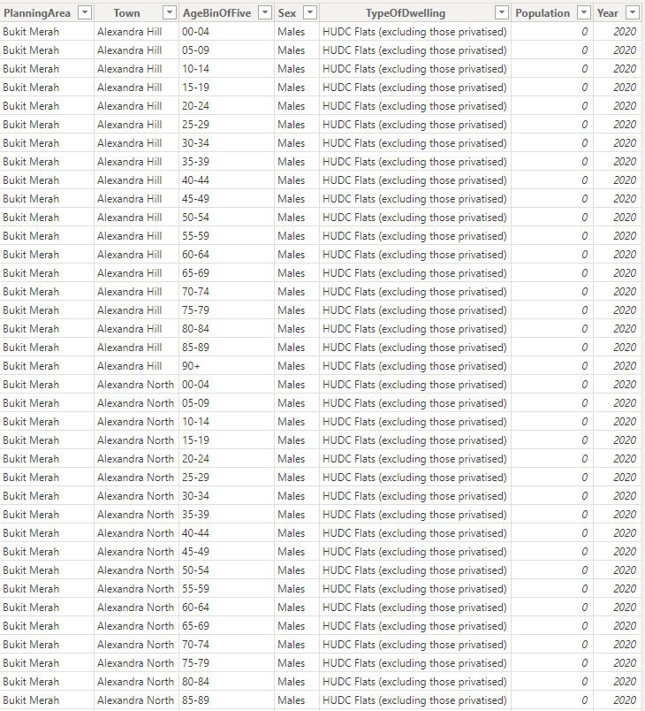
Sample Data (YearlyPopulation)

